Slide 1
AKASH A RAJESH RAJAMANIKHAM
CASE STUDY: CUSTOMER ANALYSIS FOR RETAIL

Slide 2
ANALYTICS IN RETAIL:
With the retail market getting more and more competitive by the day, there has never been anything more important than the ability for optimizing service business processes when trying to satisfy the expectations of customers. Channelizing and managing data with the aim of working in favor of the customer as well as generating profits is very significant for survival.
Ideally, a retailer’s customer data reflects the company’s success in reaching and nurturing its customers. Retailers built reports summarizing customer behavior using metrics such as conversion rate, average order value, recency of purchase and total amount spent in recent transactions. These measurements provided general insight into the behavioral tendencies of customers.
Customer intelligence is the practice of determining and delivering data-driven insights into past and predicted future customer behavior. To be effective, customer intelligence must combine raw transactional and behavioral data to generate derived measures.
In a nutshell, for big retail players all over the world, data analytics is applied more these days at all stages of the retail process – taking track of popular products that are emerging, doing forecasts of sales and future demand via predictive simulation, optimizing placements of products and offers through heat-mapping of customers and many others

Slide 3
DATA AVAILABILITY:
Retail Data.xlsx
This book has three sheets (Customer, Transaction, Product Hierarchy)
Customer: Customers information including demographics
Product Hierarchy: Product information (category, sub category etc...)
Transaction: Transactions of customers

Slide 4
BUSINESS PROBLEM:
A Retail store is required to analyze the day-to-day transactions and keep a track of its customers spread across various locations along with their purchases/returns across various categories.
Create a report and display the below calculated metrics, reports and inferences.

Slide 5
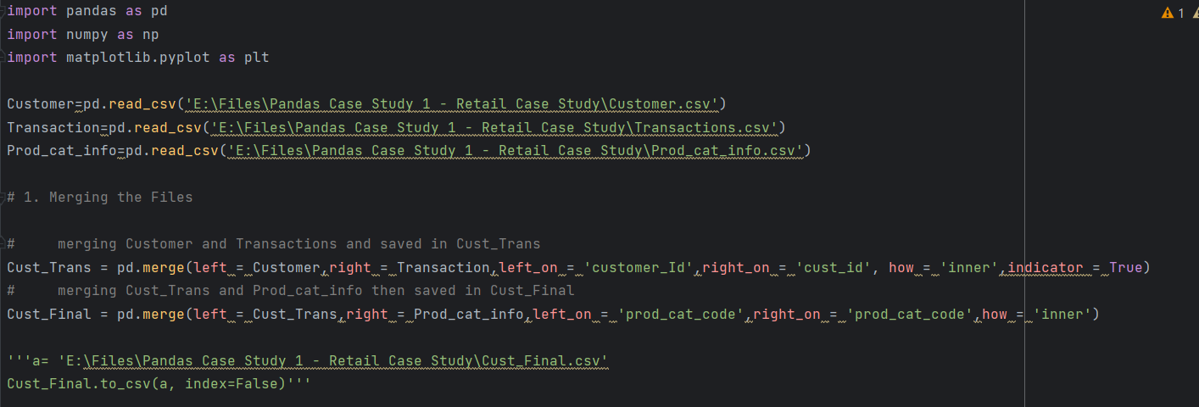
1. Merge the datasets Customers, Product Hierarchy and Transactions as Customer_Final. Ensure to keep all customers who have done transactions with us and select the join type accordingly.

Slide 6
2. Prepare a summary report for the merged data set. a. Get the column names and their corresponding data types b. Top/Bottom 10 observations c. “Five-number summary” for continuous variables (min, Q1, median, Q3 and max) d. Frequency tables for all the categorical variables

Slide 7
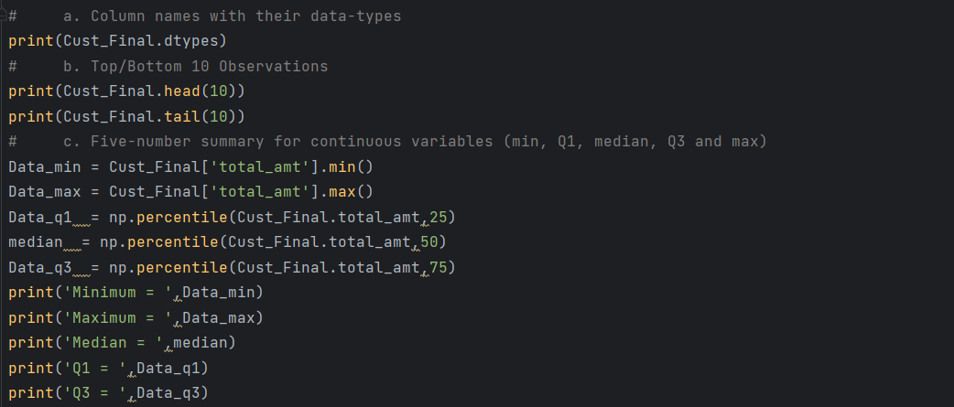

Slide 8
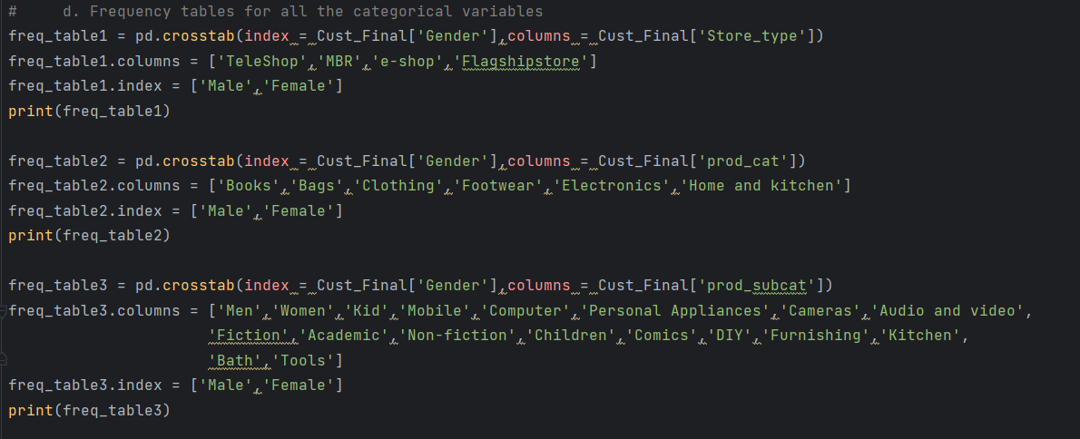

Slide 9
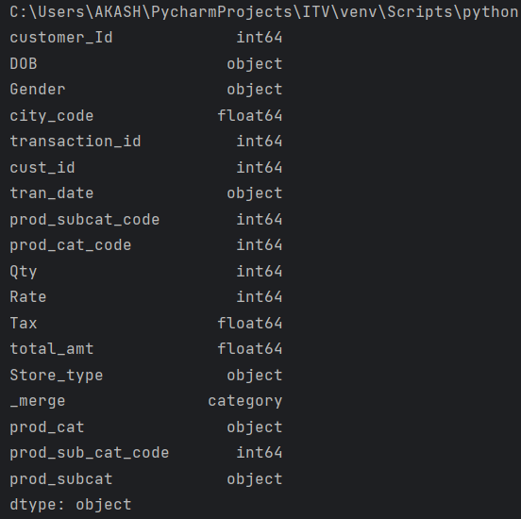
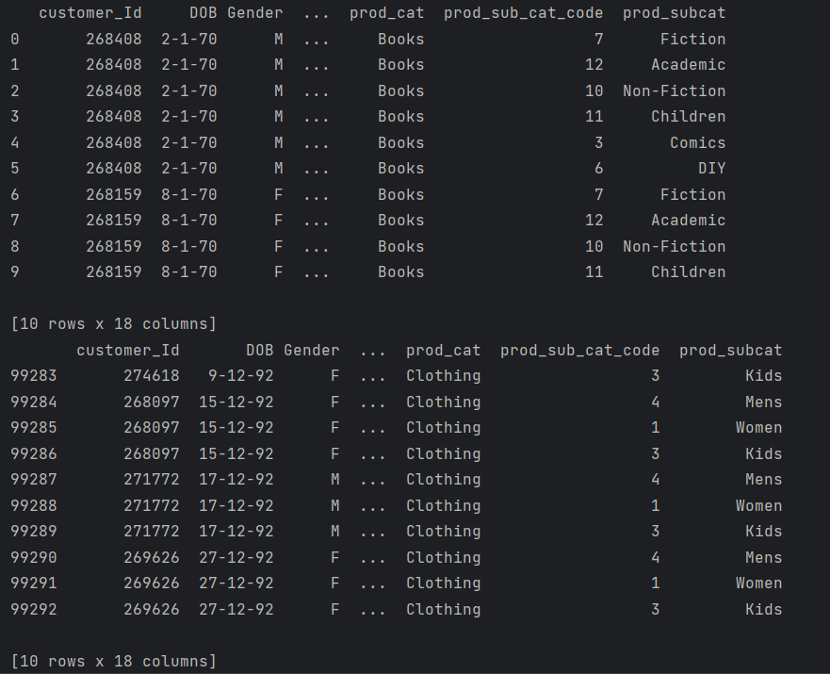

Slide 10
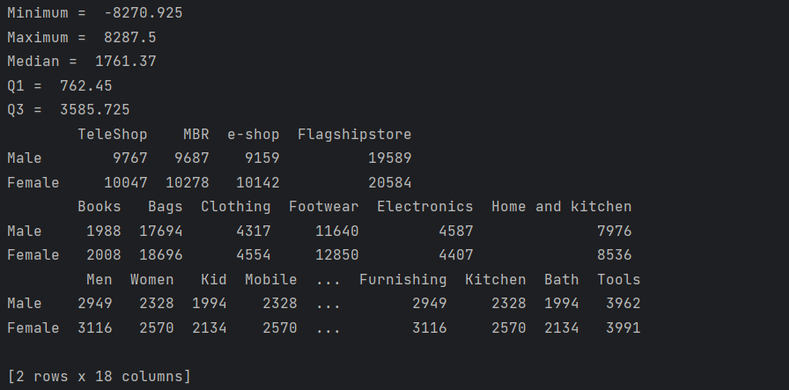

Slide 11
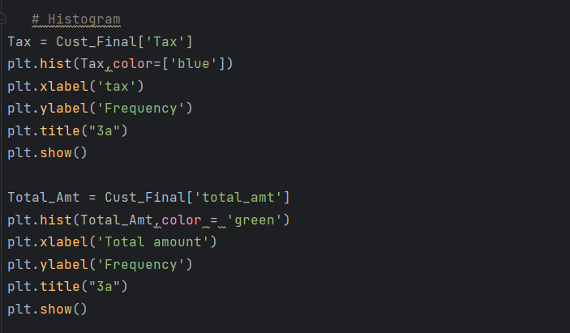
3. Generate histograms for all continuous variables and frequency bars for categorical variables.

Slide 12
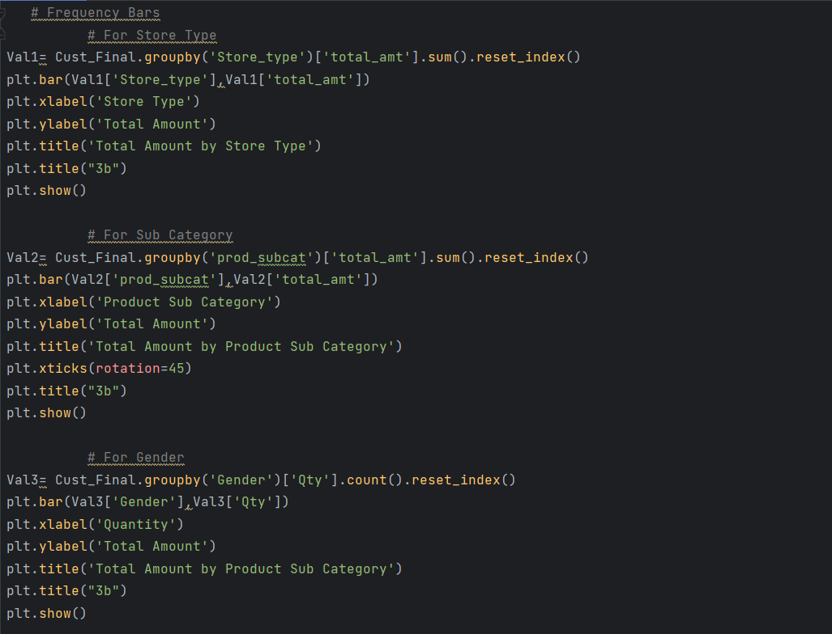

Slide 13
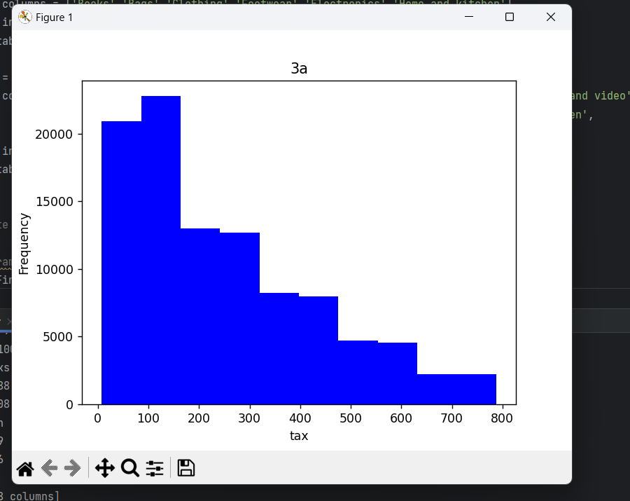
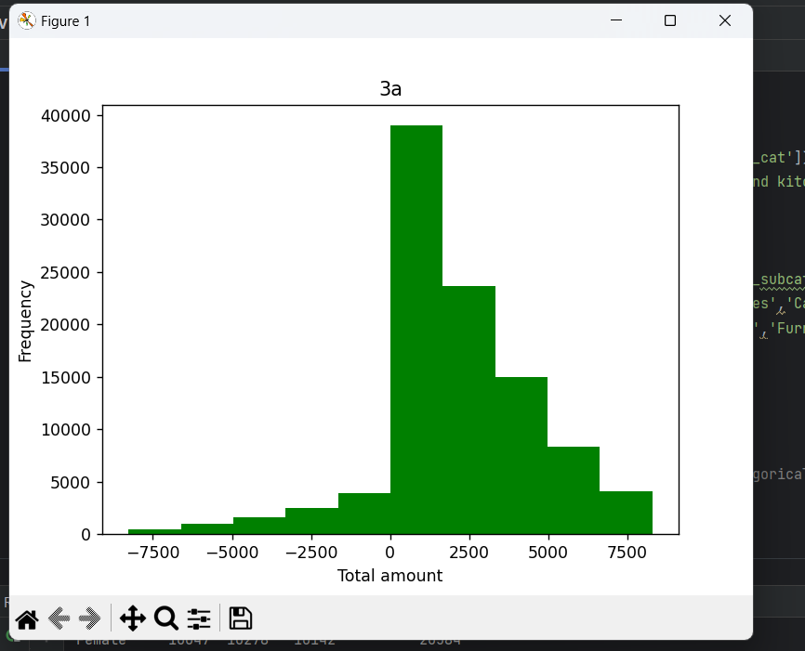

Slide 14
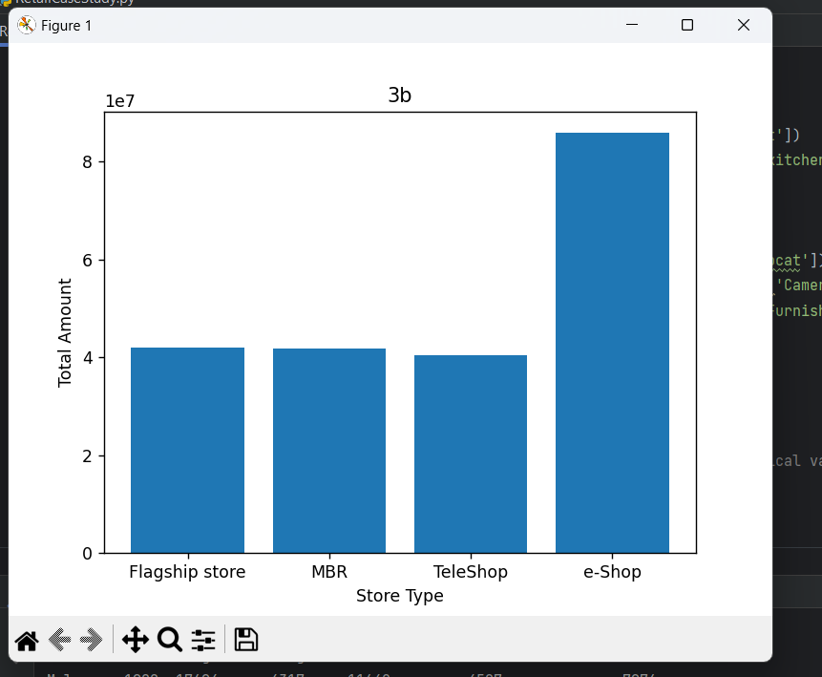
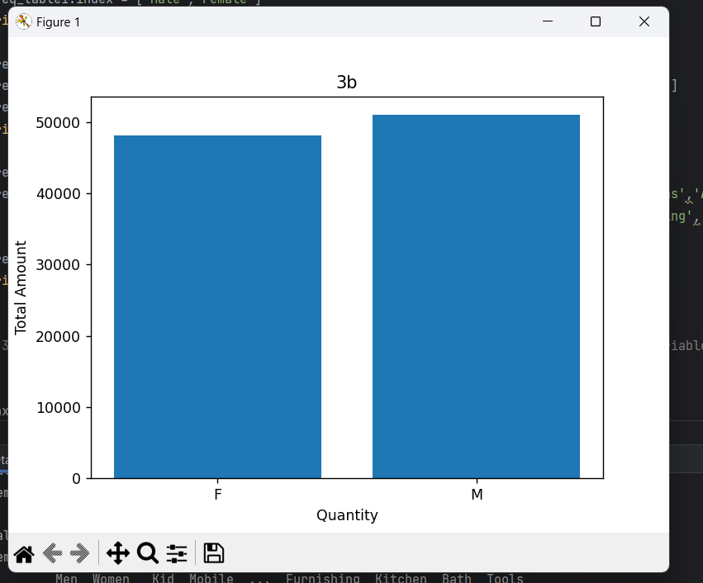

Slide 15
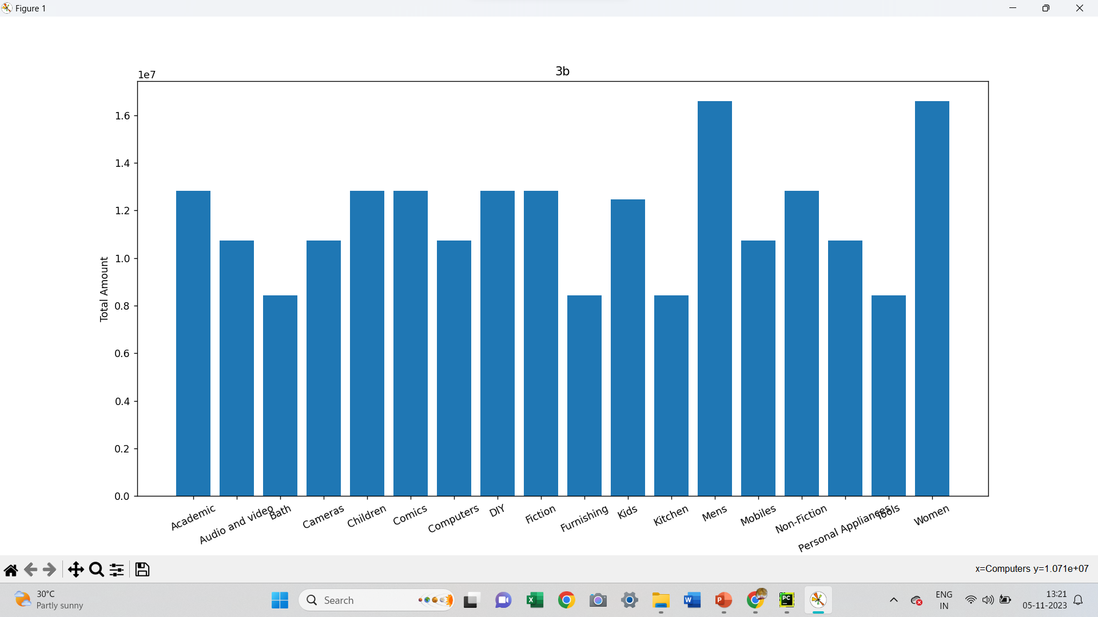

Slide 16
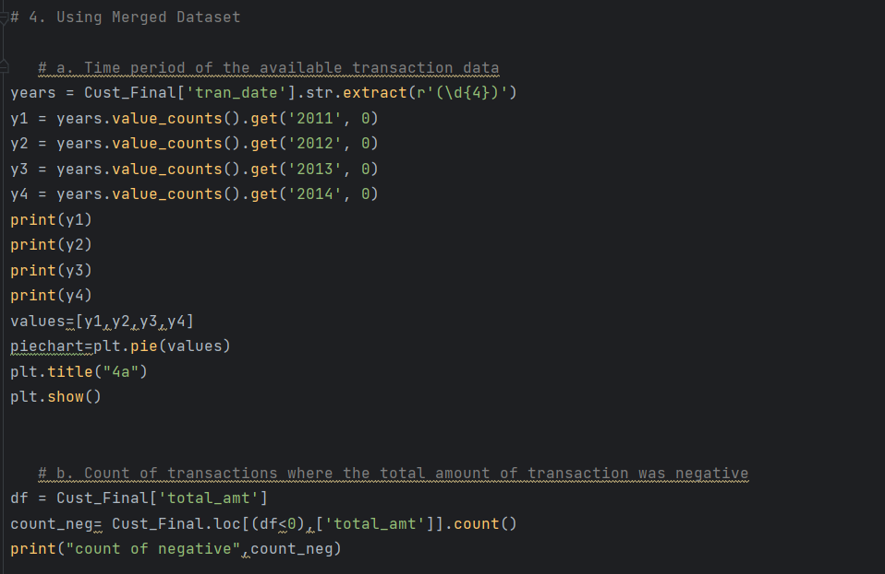
4. Calculate the following information using the merged dataset : a. Time period of the available transaction data b. Count of transactions where the total amount of transaction was negative

Slide 17
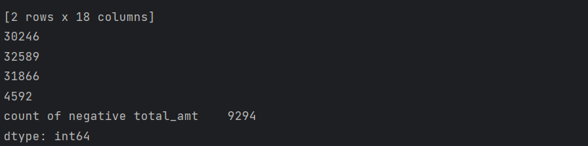
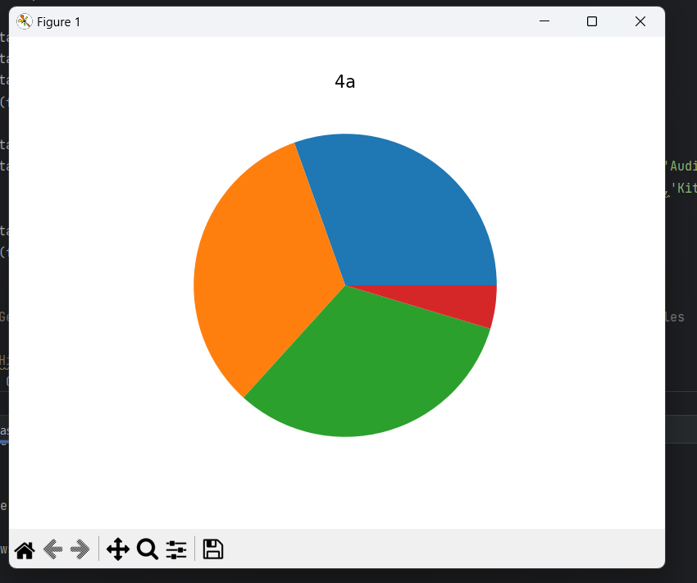

Slide 18
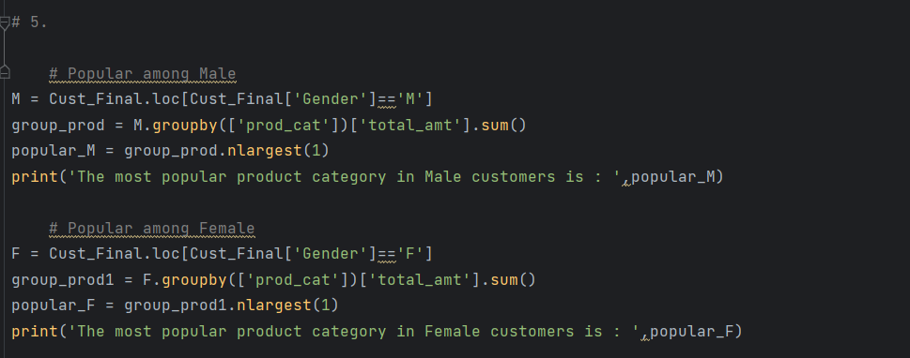
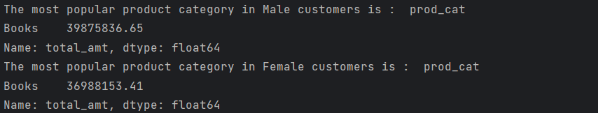
5. Analyze which product categories are more popular among females vs male customers.

Slide 19
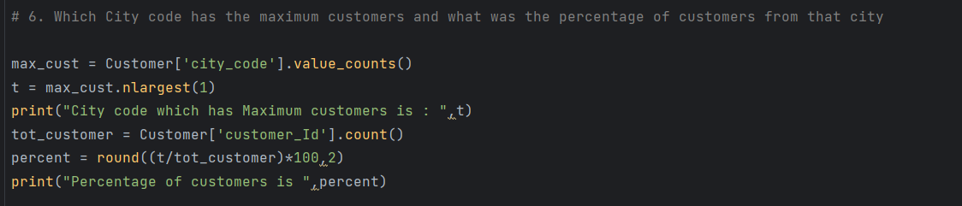
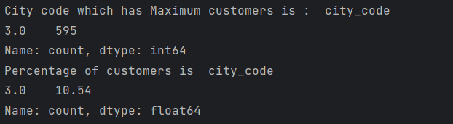
6. Which City code has the maximum customers and what was the percentage of customers from that city?

Slide 20
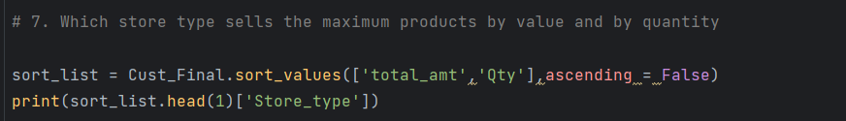

7. Which store type sells the maximum products by value and by quantity?

Slide 21
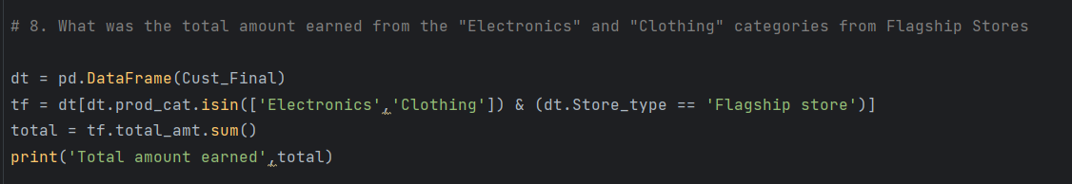
8. What was the total amount earned from the "Electronics" and "Clothing" categories from Flagship Stores?

Slide 22
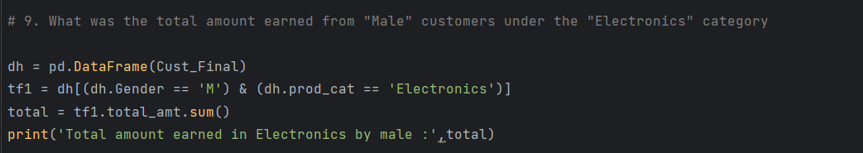
9. What was the total amount earned from "Male" customers under the "Electronics" category?

Slide 23
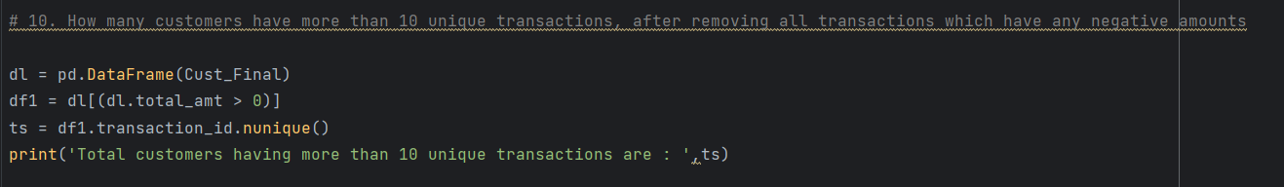
10. How many customers have more than 10 unique transactions, after removing all transactions which have any negative amounts?

Slide 24
11. For all customers aged between 25 - 35, find out: a. What was the total amount spent for “Electronics” and “Books” product categories? b. What was the total amount spent by these customers between 1st Jan, 2014 to 1st Mar, 2014?

Slide 25
